Slide 1
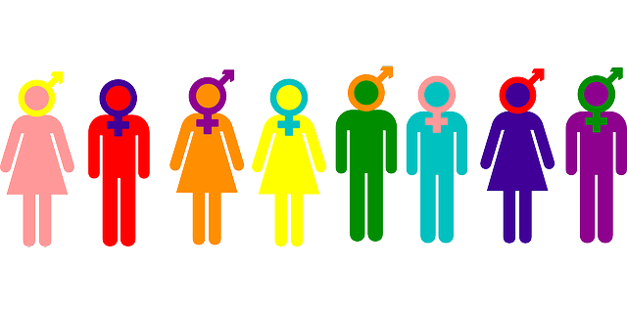

Welcome!! Let’s Talk Gender

Slide 3
Let’s Talk Gender
Today’s Aims:
To introduce the concept of gender and explore our understandings of ‘masculine’ and ’feminine’
To learn about the differences between gender identity, biological sex and sexual orientation
To reflect on how gender influences our lives
To think about how we can be aware of, and challenge, gendered stereotypes

Slide 4
1. In order to get the best out of the session, it’s a good idea to try and stay for the whole thing and be present. Find a quiet space. Put your phones aside if you can. Take this time for you.
2. Everything that we talk about tonight in this SkyCast is confidential, so we won’t discuss it with anyone outside of this session.
3. We want to create supportive space where everyone can let their feelings out, so let’s treat each other with respect, take each other’s views seriously and do our best to try and understand where people are coming from.
4. You need to look after yourself in the session and if you are struggling, you’re welcome to leave at any time, whether to log off or just to take some time out. However, please let us know by pressing the ‘I need help now’ button rather than writing something in the chat section, so that others can continue the session to the end. We will then contact you after the session with some follow up information.
5. Finally, we are entitled to share as much or as little as we want - in fact, sometimes online it might feel easier to talk about things, however, that can also leave you feeling a bit vulnerable. So we’d just ask you to only share what feels comfortable and try to check in with yourself on a regular basis to make sure you’re feeling okay.
KEEPING THINGS PRIVATE AND CONFIDENTIAL

Slide 5


Slide 6
Gender Influences
Social Influences e.g. culture
Psychological/Childhood Influences
Physical and Genetic Influences

Slide 7
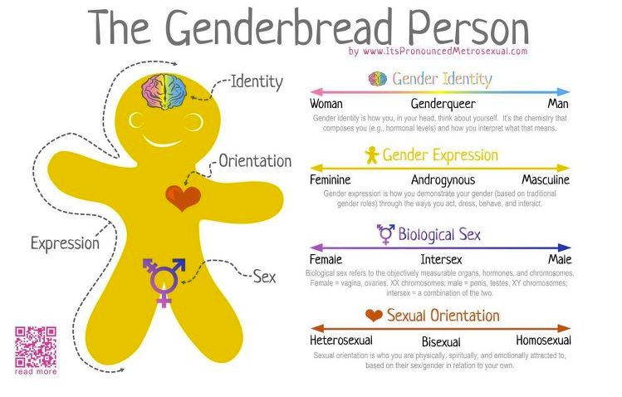

Slide 8


Challenging gender stereotypes

