Slide 1

Welcome!!
Coping with Loss
SkyCast

Slide 2


Slide 3
Coping with Loss
Today’s Aims:
To explore our thoughts and feelings about death
To talk about signs, symptoms and stages of grief
To examine the myths and misunderstandings about loss
To share our ideas, experiences and coping strategies in helping us cope with loss

Slide 4
1. Firstly, we agree that everything that is said in the session is confidential and that we won’t discuss it with anyone outside of this session
2. We all agree to listen to each other and give people a supportive space where they can let their feelings out
3. We will treat each other with respect, take each other’s views seriously and do our best to try and understand where people are coming from, even if we disagree with something they are saying
4. We all agree that we are entitled to share as much or as little as we want – there’s no obligation to say anything during these sessions, but also if you want some time to talk about your situation, that’s okay…
KEEPING THINGS PRIVATE AND CONFIDENTIAL

Slide 5
Symptoms of Grief
Emotional | Physical
Overwhelmed | Health Issues e.g. colds, infections
Feeling like nothing else matters | Insomnia/Nightmares
Fear and anxiety | Fatigue and exhaustion
Guilt, blame, regret | Nausea
Feeling numb | Headaches
Feeling emotionally sensitive | Changes in appetite
Anger or irritability | Prone to accidents
Helplessness or loss of control | Hypersensitivity (feeling on edge)
Depression and despair | Changes to memory/forgetfulness
Suicidal thinking (loss of meaning/purpose) | Difficulty concentrating

Slide 6
Normal vs Complicated Grief
Reaction | Normal | Complicated
Guilt and Regret | Early reaction, can last weeks or months, usually fades into regret | Dominates other reactions, can be a major problem years later. Symptoms include: feeling suicidal, relationship problems, refusal to talk, dazed, excessive self-blame, loss of memory of the deceased and health problems.
Sadness and Depression | Bouts of intense sadness are normal, especially in the early months. Those with a history of depression may be anxious that it may re-occur. | Depression and deep grief continue for many years. Symptoms include: relationships being affected, long and deep sadness (particularly around anniversaries), rarely happy, often tearful.
Fears and Phobias | Fear and insecurity are normal after a loss but you may fear yours and other’s mortality. | Fears continue to affect life long after the bereavement. Symptoms include: isolation, phobias, panic attacks, life restricted, relationship problems
Suicidal Thoughts | Most bereaved people question the meaning and purpose of their lives | No meaning or purpose continues for a long time after the loss.
Grief and Mental Health | Many people feel they are going mad after a loss | Concerns over mental health persist long after the bereavement

Slide 7




Grief is a Process!

Slide 8
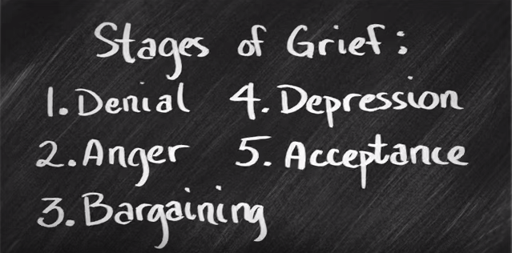
Stages of Grief

Slide 9
5 Things to Remember
  It’s just a theory (and there’s lots of theories!)
  It’s not linear (Grief is like a labyrinth, not a tunnel)
  You may go through some stages twice (or three times, or four… or more)
  It’s not all encompassing (You might feel things like regret, which aren’t on the list!)
  There is no end point!

Slide 10
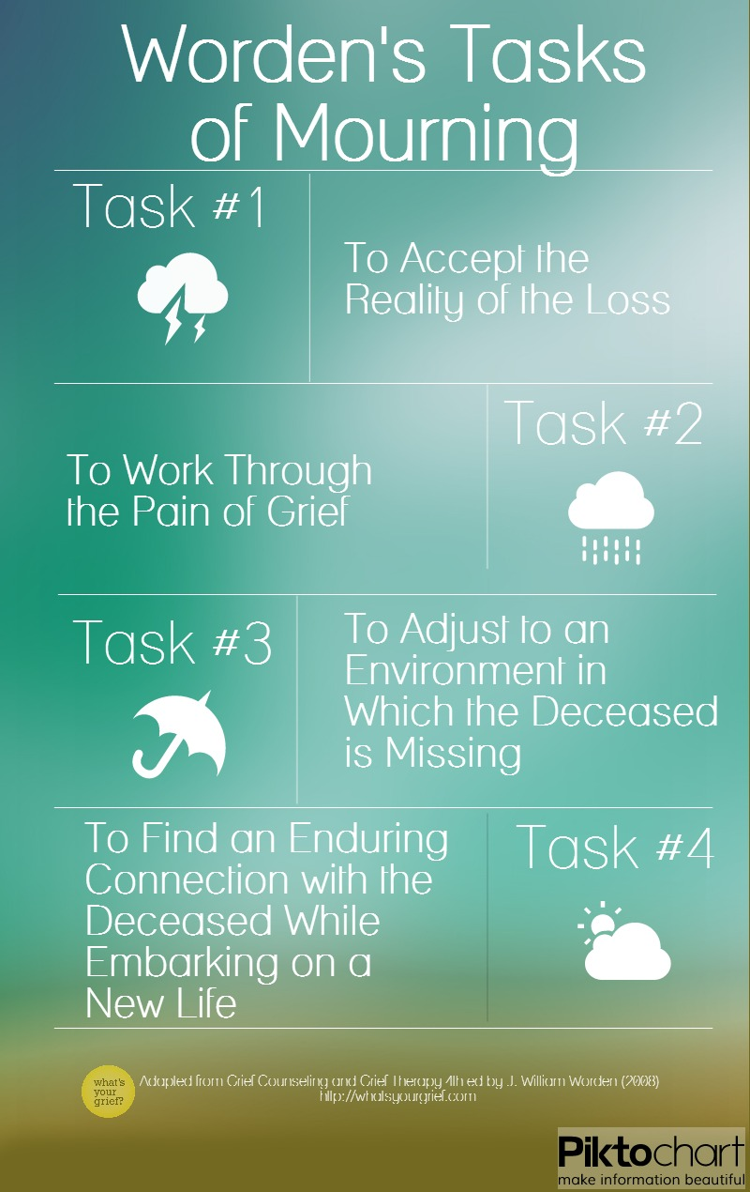

Slide 11
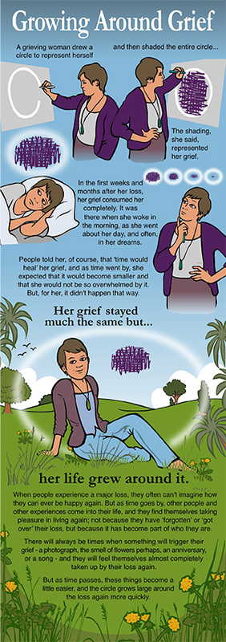

Slide 12
Do’s and Don’ts
Do | Don’t
Be there for the person who is grieving – pick up the phone, write a letter, call or arrange to visit | Avoid someone who has been bereaved
Encourage the person to talk and listen to them | Use cliché’s: I understand how you feel You’ll get over it Time heals
Accept that everyone grieves in their own way – there is no ‘normal way’. Be aware that grief can take a long time | Tell them it’s time to move on, they should be over it – how long a person needs to grieve is entirely individual
Create an environment in which the bereaved person can be themselves and show their feelings, rather than having to put on a front
Contact the person at difficult times, like special anniversaries and birthdays….

Slide 13





TimeFrames
&
Milestones

